Slide 1
Unity Scripting
Scripting Essentials

Slide 2
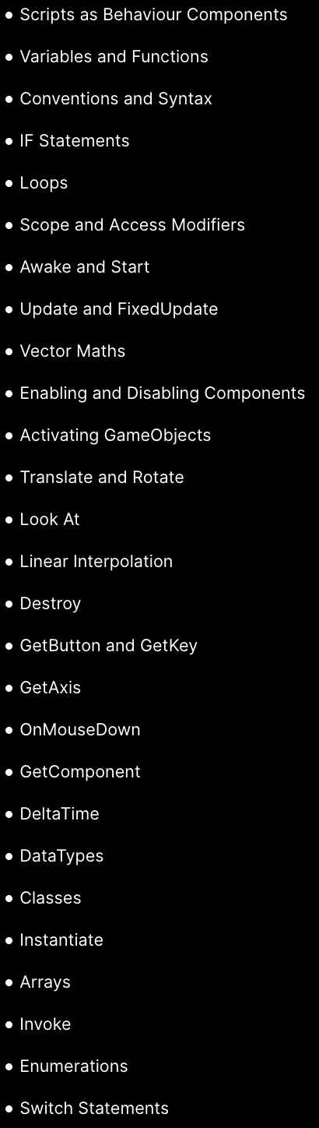
Learning Resources
Link to Beginner Scripting tutorials: https://learn.unity.com/project/beginner-gameplay-scripting?language=en&courseId=5c61706dedbc2a324a9b022d
Unity Documentation: https://docs.unity.com/

Slide 3
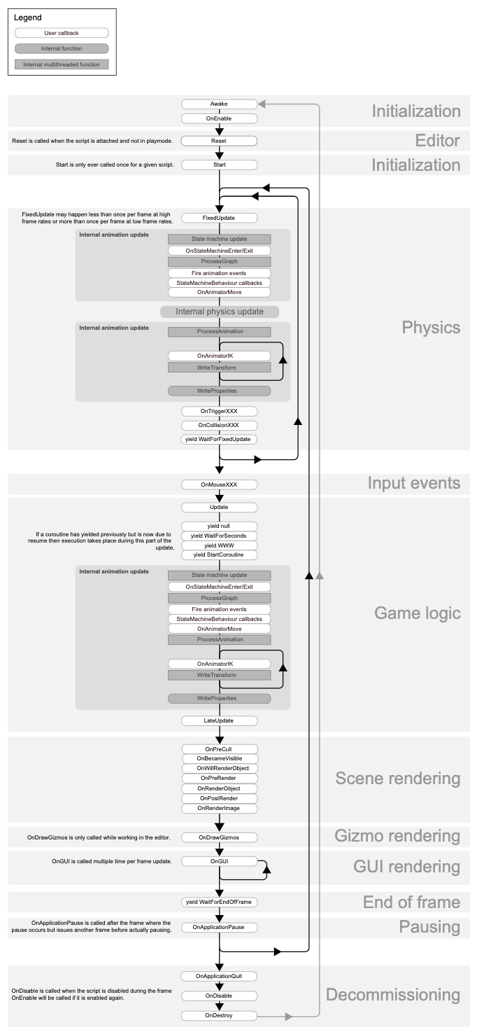
Unity, The Basics
Scripting language: C#
Framework and base class: MonoBehaviour
Lifecycle and Order of Execution of MonoBehaviours in Unity
Components based System
Link lifecycle flowchart: https://docs.unity3d.com/Manual/ExecutionOrder.html

Slide 4
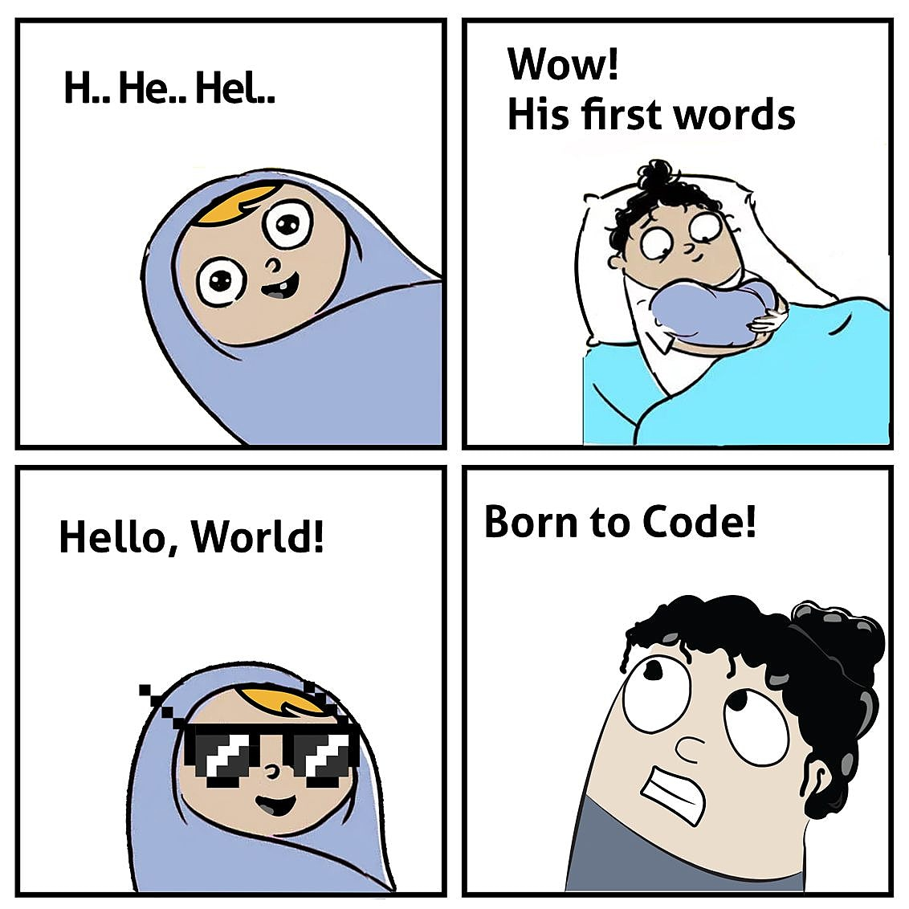
Let’s create our first…
Hello World!

